Slide 1
K-Means Parallel Project
Massive DyNamic:
Liron Mizrahi, Daniel da Silva, Fran-pierre Nel and Jason Chalom

Slide 2
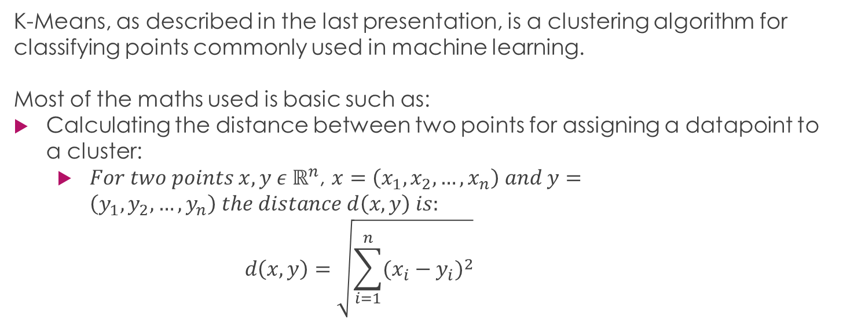
Maths Behind K-Means
K-Means, as described in the last presentation, is a clustering algorithm for classifying points commonly used in machine learning.
Most of the maths used is basic such as:
Calculating the distance between two points for assigning a datapoint to a cluster:
$For two points {x,y ε ℝ}^{n}$, $x=\left(x_{1}, x_{2}, …, x_{n}\right) and y=\left(y_{1}, y_{2}, …, y_{n}\right) the distance d\left(x,y\right) is:$
$$d\left(x,y\right)=\sqrt{\sum_{i=1}^{n}{{{(x}_{i} − y_{i})}^{2}}}$$

Slide 3

Maths Behind K-Means
Calculating the average of several points to move the cluster centre to a new location:
$For a cluster j:$
$$mean\left(cluster j\right)= \frac{1}{N_{j}} \sum_{x ε μ_{j}}{x}{; N}_{j}= number of elements in cluster j$$

Slide 4
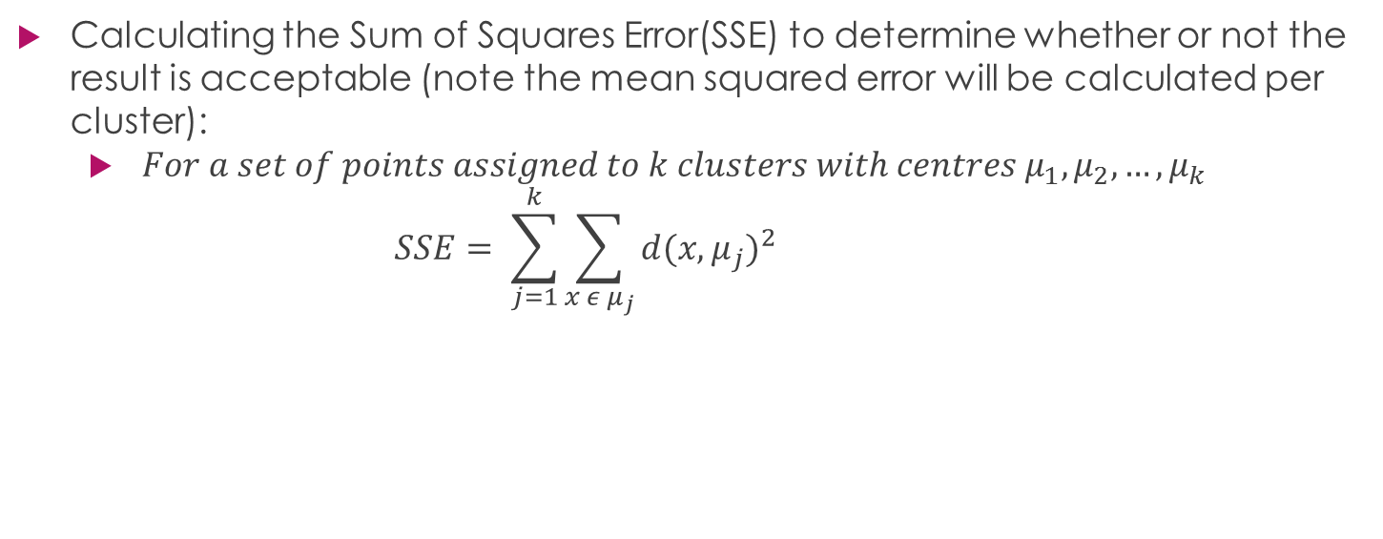
Maths Behind K-Means
Calculating the Sum of Squares Error(SSE) to determine whether or not the result is acceptable (note the mean squared error will be calculated per cluster):
$For a set of points assigned to k clusters with centres μ_{1}, μ_{2}, …, μ_{k}$
$$SSE= \sum_{j=1}^{k}{\sum_{x ε μ_{j}}{{d(x,μ_{j})}^{2}}}$$

Slide 5
Revisiting the Decompositions
The decomposition was revised as it was realized that the average can start being calculated as the points are assigned to a particular cluster.
This is done by having two variables assigned to a cluster to keep track of the number of points assigned to a cluster as well as the sum of the distances from the cluster centre to assigned points.
In short, the average is slowly being calculated during the ASSIGNMENT phase as opposed to being it’s own section.
This should provide better speedup as it avoids redundant work being done.
A barrier will be used after the ASSIGNMENT section of code after which division will be done per cluster to determine the final cluster centre.
It has not yet been determined whether the division will be done in serial or parallel.

Slide 6
Revisiting the Decompositions
It is important to note that other such decomposition improvements may arise as the project goes on.
We intend to compare the new potential decomposition with the old one and choose the better of the two.

Slide 7
Data Decomposition

Slide 8
Task Dependency

Slide 9
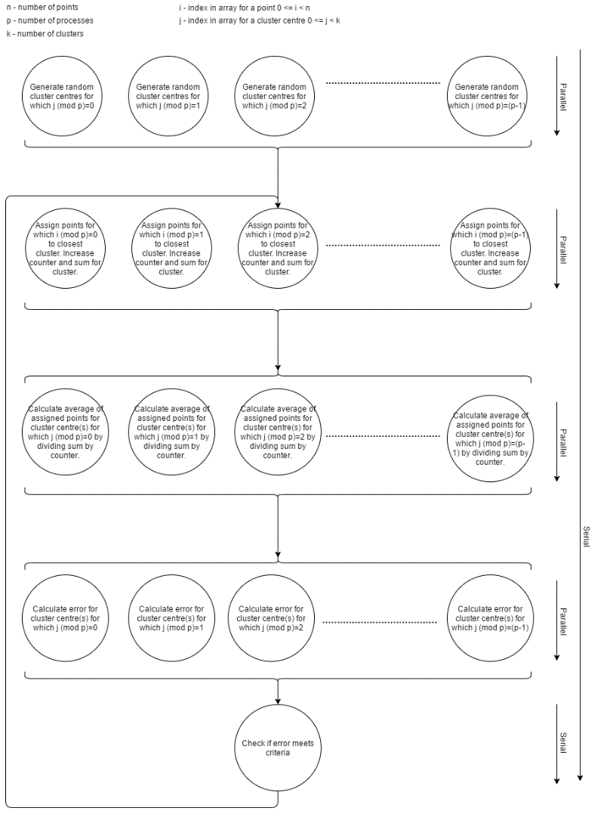
Task Decomposition

